Slide 1

Executive Safety Responsibility
Ted Schorn
Schorn Consulting, LLC
Indianapolis, IN

Slide 2


Why am I here?

Slide 3
Goal of the paper
Apply research to define the necessary executive contribution to achieve excellent safety performance

Slide 4
Structure
Introduction
  Who is an executive?
  How shall we measure safety performance?
An Executive has a nondelegable responsibility for safety
Safety Performance Factors
Executive Behaviors

Slide 5
Executive Responsibility
Positive Argument
Negative Argument
Stewardship for
People
Reputation/Image
Goods
Poor safety performance attacks all three of these aspects
The morality of responsibility
There is no one else
  Not the worker himself
  Not the supervisor or middle management
  Not the safety professional
  Not random chance
Executives wield decisive influence on these intermediaries

Slide 6
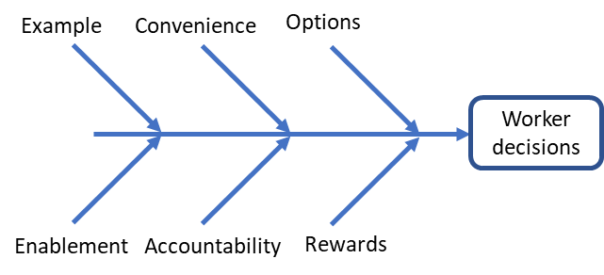
Safety Performance Factors: Culture
“How we do things around here”

Slide 7

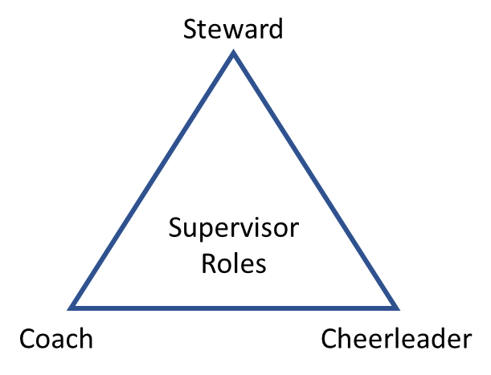
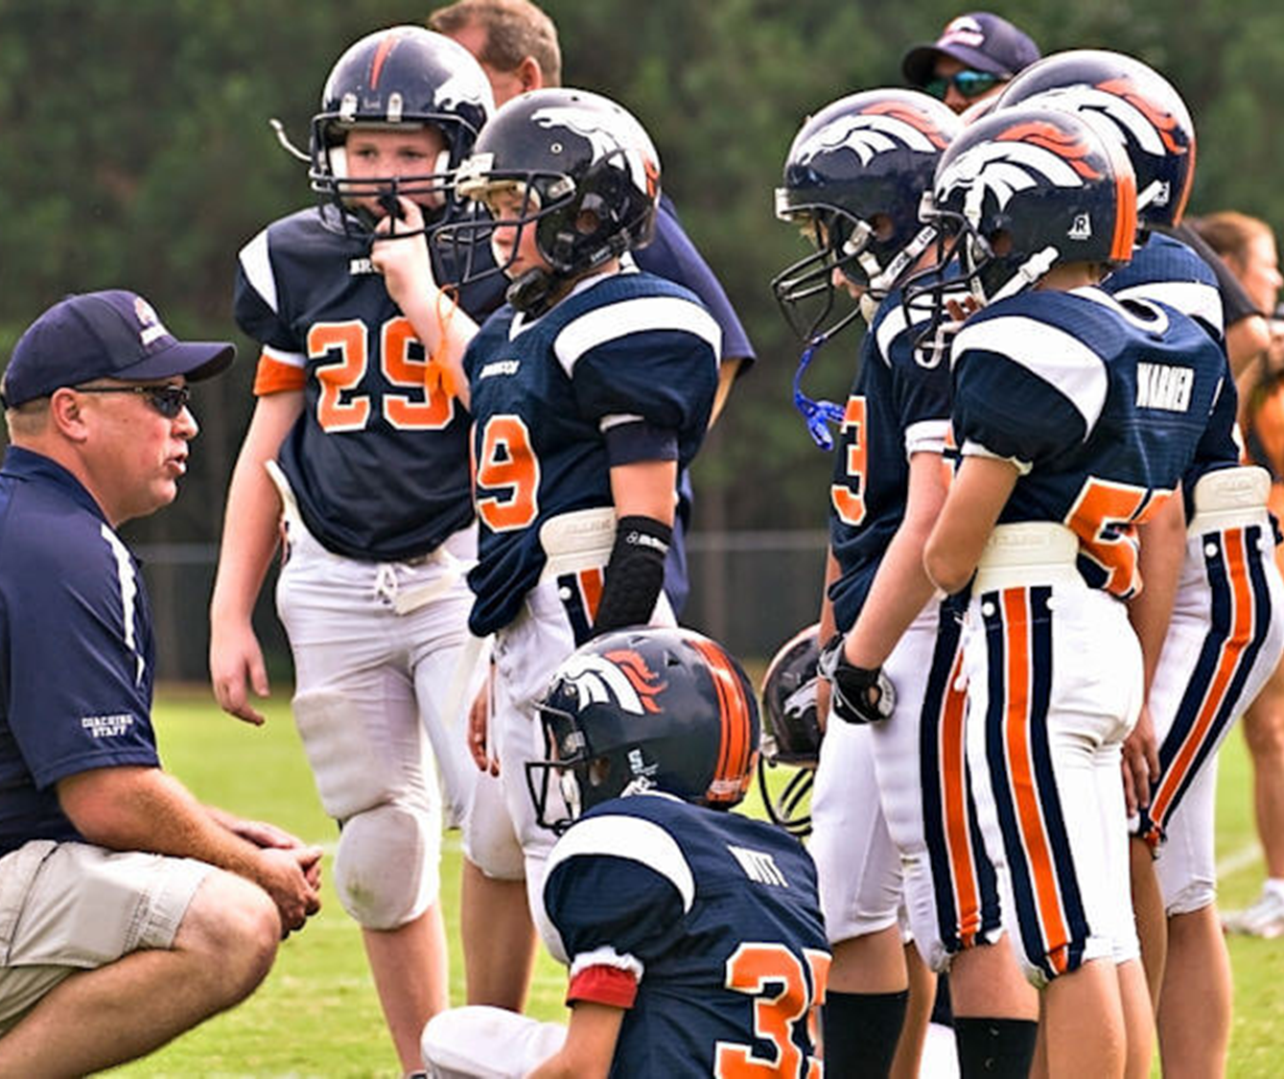

Safety Performance Factors: Supervision

Slide 8
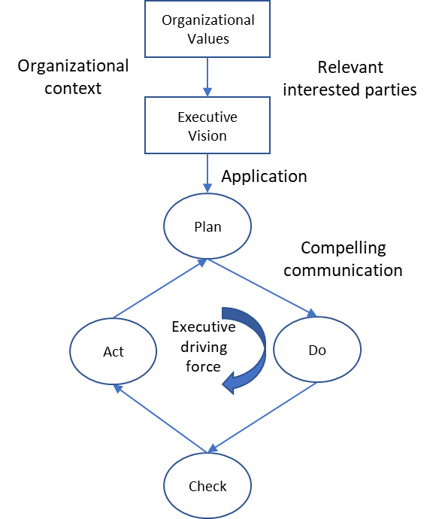
Executive behaviors: Process-Driving
Values reflection / communicate / address gaps
Gaps highlight vision for future state
Vision is informed by situation and stakeholders
Personal involvement in planning
Compelling communication
Interest in progress at every level
Preside over progress reviews; expect action
Root out rebellion/naysayers but embrace loyal contrarians
Praise

Slide 9
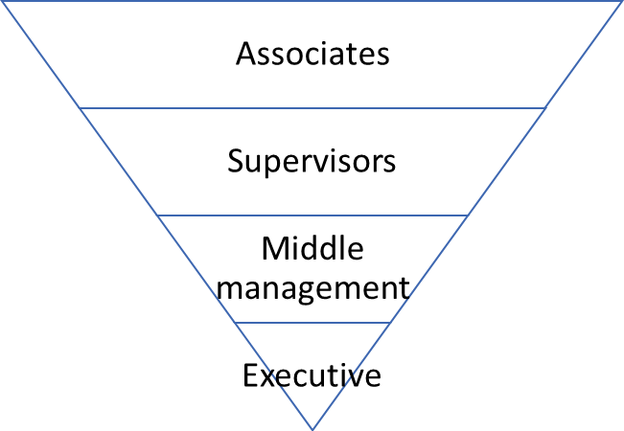
Executive behaviors: Values-Communicating
Understand leadership as a support role
Teach and model organization as the inverted triangle with focus on the contact points above and below
Good leaders do not create followers; they create other leaders – build values and methods into direct reports
Performance appraisal is focused forward and people care centered with safety results and values a key contribution
Model the behavior and attitude
Use survey data but cautiously

Slide 10
Summary
Executives cannot evade their responsibility for guiding the performance of their organization in every aspect
The energy for change comes from values, not a need for compliance; the “why” matters
Executives ought to support (empower and guide) their professional safety staff, not the other way around
Safety leadership is leadership – Good leaders drive great results in every area because they driven by positive values and a fundamental regard for people care

