Slide 1
HAZ-WHAT?
Chris Salemink, SGE, CSM, QSSP
Cintas First Aid & Safety
Regional Training and Compliance Specialist

Slide 2
HAZ-WHAT?
HAZCOM – 29 CFR 1910.1200
HAZMAT Shipping and Receiving – 49 CFR 100-185
RCRA Hazardous Waste – 40 CFR 260
HAZWOPER – 29 CFR 1910.120

Slide 3
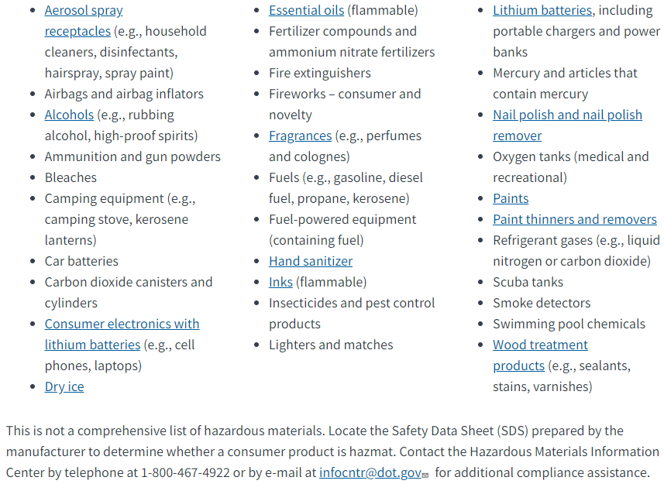
HAZMAT – What Classifies as HAZMAT?

Slide 4
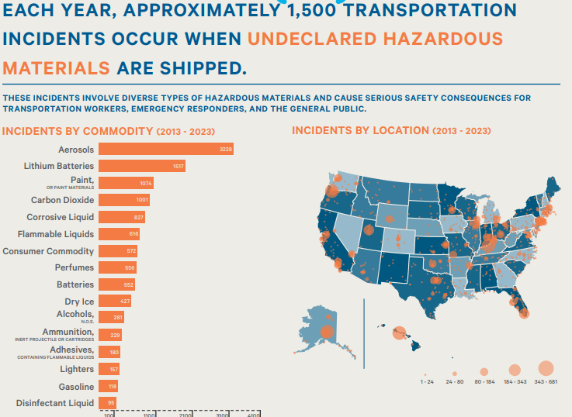
What is at risk?
Violation of hazmat regulations:
$89,679 - $96,624
Violation resulting in death/severe injury:
$209,249 - $225,455
Violation of hazmat training regulations:
$540 - $582

Slide 5
Where do I start?
Identification and Awareness
Training – 49 CFR 172, Subpart H
Any employee who directly affects hazmat transportation (loading, unloading, design,
Required upon initial assignment and every 3 years thereafter

Slide 6
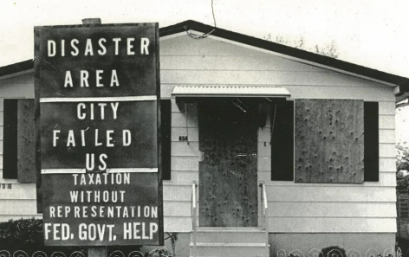
Resource Conservation and Recovery Act (RCRA)
What is hazardous waste?
Simply defined, a hazardous waste is a waste with properties that make it dangerous or capable of having a harmful effect on human health or the environment.
Why are we concerned with hazardous waste?
Love Canal

Slide 7
RCRA – Waste Generator Quantities

Slide 8
What is at risk?

Slide 9
Where do I start
Identification and Awareness
Training – 40 CFR 262.17
“all persons who work at, or oversee the operations of, a hazardous waste facility and whose actions or failure to act may result in noncompliance with the requirements (of the RCRA regulations).” – 40 CFR 260.10
Required initially and every year thereafter
Large and small quantity generators, not very small quantity generators

Slide 10
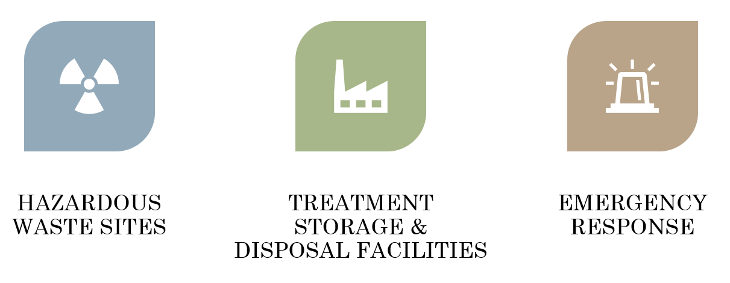
Hazardous Waste Operations and Emergency Response (HAZWOPER)

Slide 11
HAZWOPER – Emergency Response
Process Safety Management – 29 CFR 1910.119
Emergency Planning and Response
EPA – Risk Management Program, Emergency Response Program– 40 CFR 68.93

Slide 12
HAZWOPER

Slide 13
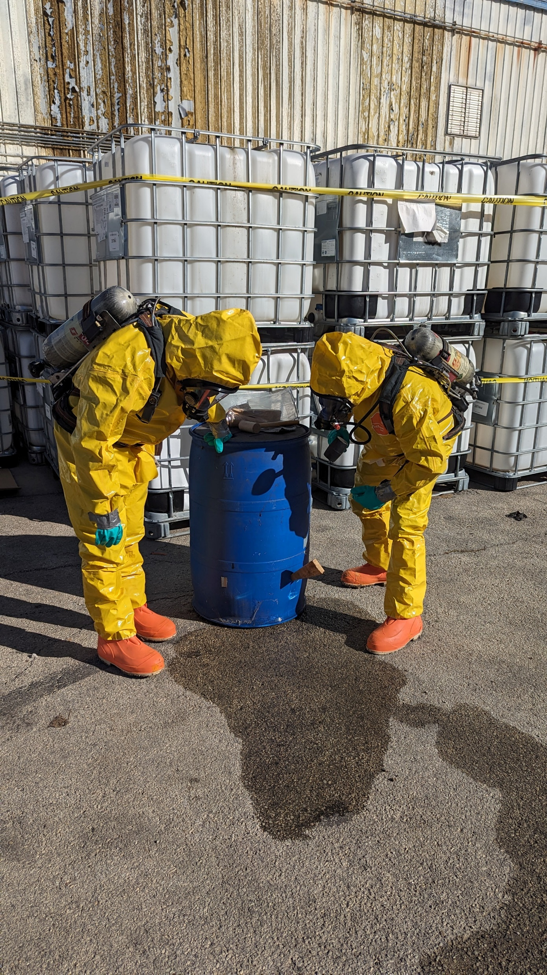
HAZWOPER – Emergency Responders
Refresher – minimum 8 hours annualy
(maintain competency)
Awareness Level - 4 to 8 hrs.
Recognition
Operations Level - min. 8 hrs.
Defensive operation
Technician Level - min. 24 hrs.
Offensive operations
Specialist Level - 40+ hrs.
Various specialized areas
Incident Commander - 48+ hrs.
Special training in ICS and termination

Slide 14
Where do I start?
Identification and Awareness
Emergency Response Plan Creation
Equipment Procurement
Training

Slide 15
Questions
Chris Salemink
Cintas Regional Training and Compliance Specialist
Saleminkc@cintas.com
260-302-3112

