Slide 1
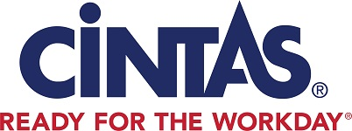

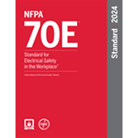
NFPA 70E PPE Best Practices
101’s of NFPA 70E, PPE and Training
Drew Simashkevich
614-578-3411
SimashkevichD@cintas.com
Notes:
Thank you for this time with you all and I love being surrounded by others in Safety! ASSP is the gold standard for safety professionals . Cintas attends the yearly ASSP National Convention and have a long history of partnering with ASSP. and I’m a member of the local chapter NW Chapter in the Twin Cities.

Slide 2
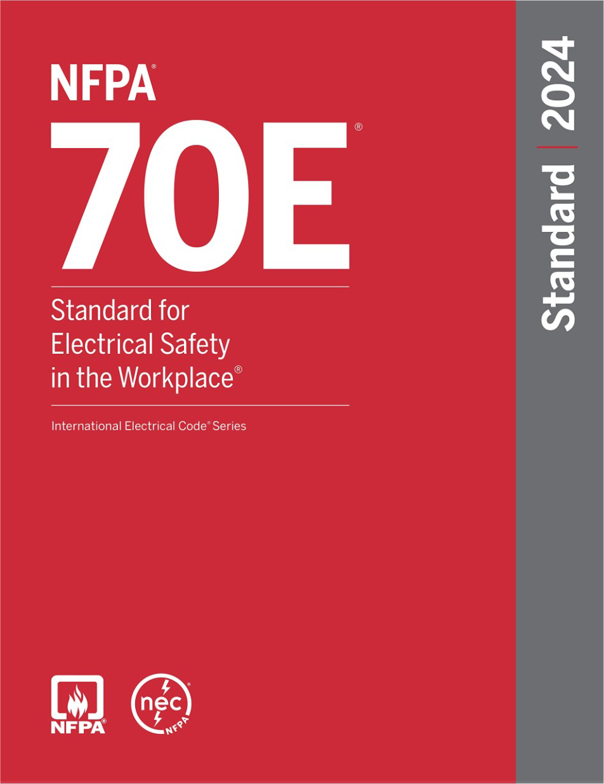
Agenda
-Understanding the Hazards
-Evolution of NFPA 70E
-2024 Edition Key Updates
-Risk Assessments
-Comprehensive NFPA 70E Program
-Difference between Non-FR vs FR
-Proper PPE and Options
-Care, Maintenance, & Proper Use
-Best Practices
-Conclusions & Next Steps
-Questions
Notes:
Hello and good morning….My name is Kevin Best and I am a Regional Director of Protective Apparel at Cintas. For the last 12.5 years I have been designing FR & PPE programs for companies large and small that deal with arc flash, flash fire, & molten metal hazards. I also have the pleasure of having Dave Bingham, National Director of AEDs at Cintas here to discuss our topic today: CPR, AED’s & How They Relate to NFPA 70E.
Couple housekeeping topics:
-Restrooms
-Fire
-Tornado
-FR, PPE, & AED that were handed out (Interactive Presentation)
-Evaluation
We are going to handle our next 60 minutes with you in two segments….discussing arc flash & shock hazards. Both are critical priorities for safety managers. Let’s get started!
Who do we have in the room today? Safety / Operations / Electrical?
How many of you require your employees to work on or near energized parts?

Slide 3
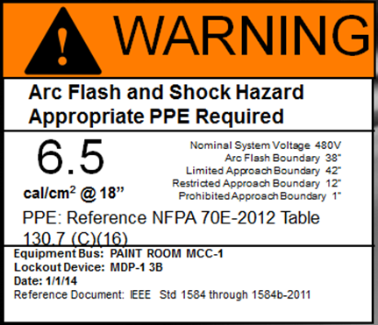
Respecting and Understanding the
Hazards
Arc Flash Hazard:
A dangerous condition associated with the possible release of energy caused by an electric arc.
Shock Hazard:
A dangerous condition associated with the possible release of energy caused by contact or approach to energized electrical conductors or circuit parts.
Notes:
Read the different Hazards….
Talk about labels on panels and the key information on them. They should be updated every 5 years during the Risk Assessment.

Slide 4
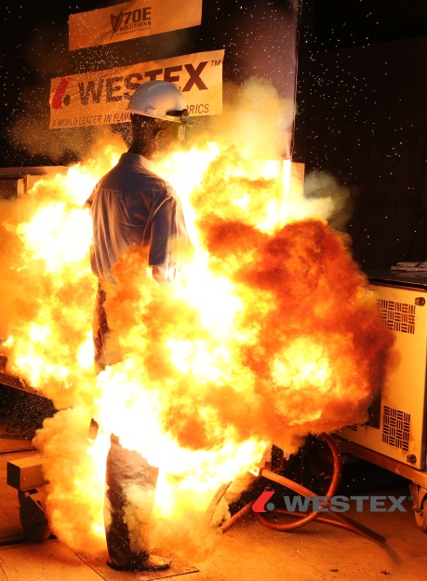
Not IF, but When
Statistics:
30,000 arc flashes/year (NFPA)
7,000 result in injury (OSHA)
2,000 admitted to burn center
300-400 fatalities annually
Notes:
These numbers are starting to go down yearly which is great to see and much of it is through education, those in safety roles taking it much more seriously and companies respecting the safety professional role.

Slide 5
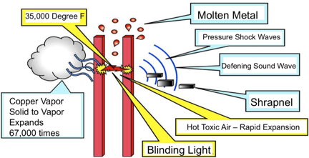
Why an
Arc Flash is
Dangerous
You don’t get just one…you get them ALL!
Heat
Molten Metal
Sound
Toxic Air
Pressure
Shrapnel
Notes:
An Arc Flash has many different hazards you need to be aware of..

Slide 6
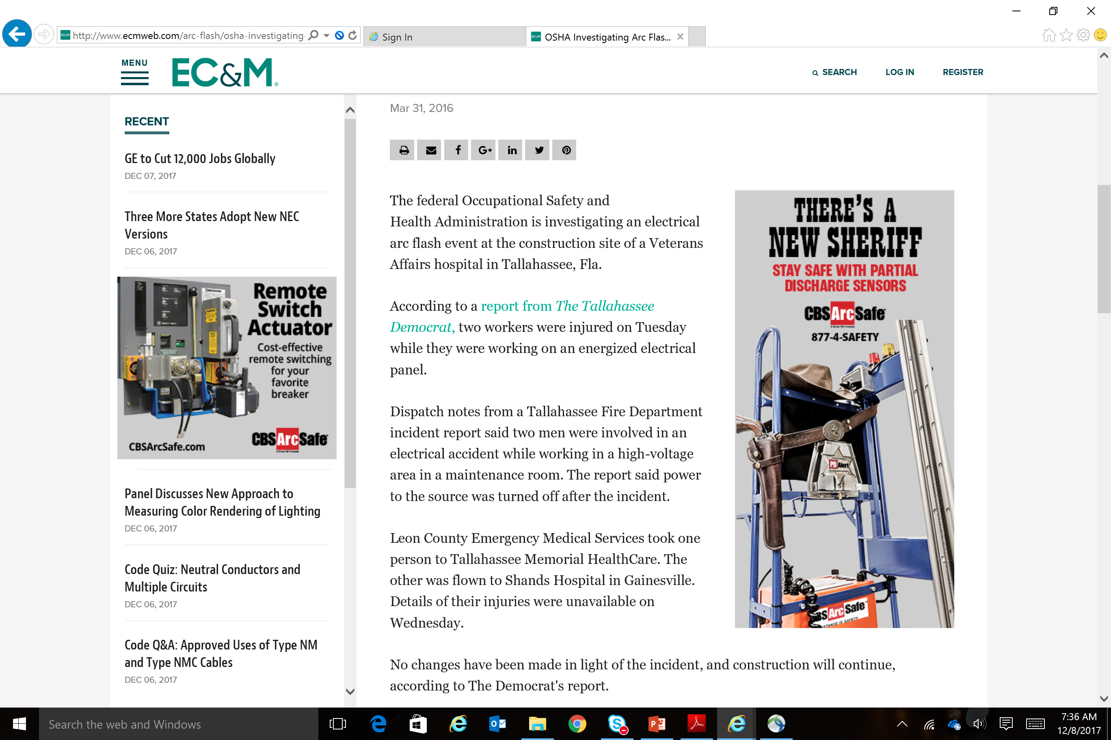
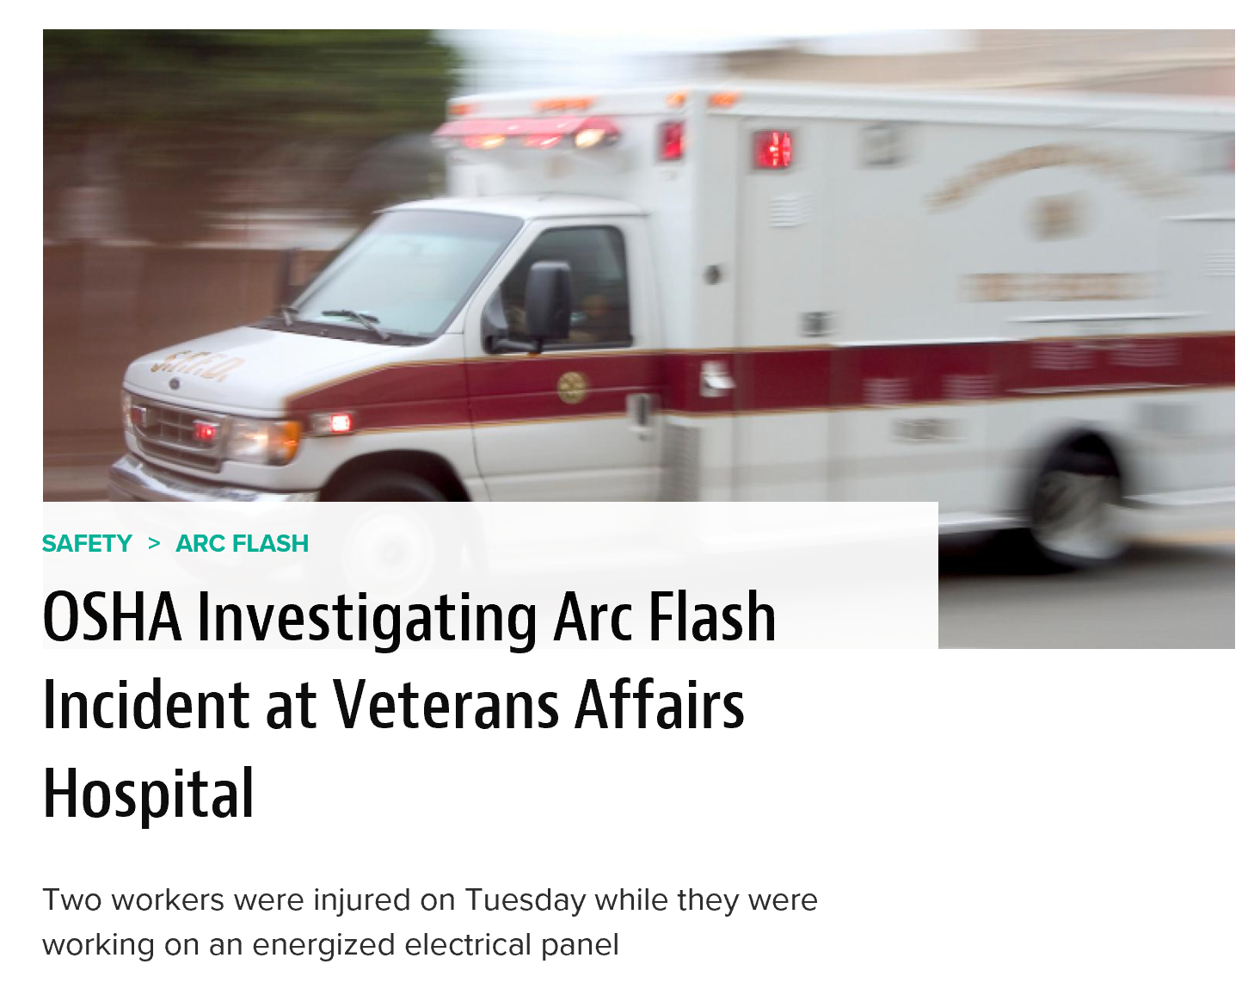
Yes, Hospitals Too
Notes:
Hospitals also have these happen. Some in the industry believe since they have a burn center they are in a better position to help someone then those who don’t. That’s the wrong thinking. They allow many to wear poly/blend clothes because of costs and comfort (per those who have told me) or wear it under their FR/AR coverall. A no no…sometimes it’s from a lack of education and how it’s always been done and they haven’t adapted to the changes.

Slide 7
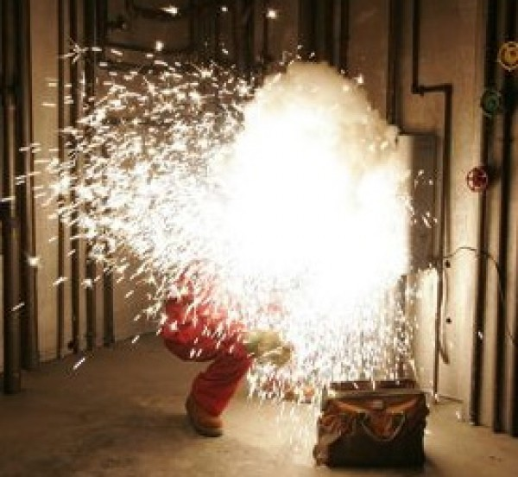
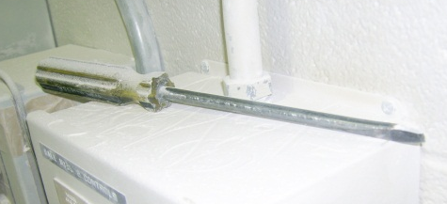
Common Causes of Arc Flash
Lack of properly de-energizing equipment
Human Error
Uninsulated Tools
Phase to Phase Contact
Phase to Ground Contact
Rodents, Bees, Reptiles
Any element in a breaker or service area, that could compromise the distance between energized components

Slide 8
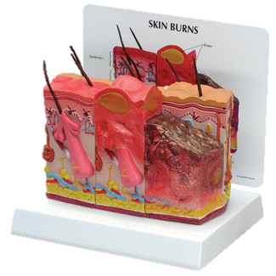
Understanding Body Burn
1st Degree
  Red skin, no blister
2nd Degree
  Blisters and epidermis must regenerate
3rd Degree
  Full-thickness burn, skin cannot regenerate, & and scar tissue forms
4th Degree
  Damage to muscle & and bone
++ Internal Inhalation Injuries

Slide 9

The Cost of Body Burn
Direct Costs:
Medical
Wage Indemnity
Claims & Admin Fees
Additional Costs:
General Liability Costs & Litigation
Lost Productivity & Quality
Insurance Premiums
Damage to Public Image
Potential OSHA Fines
Opportunity Costs

Slide 10

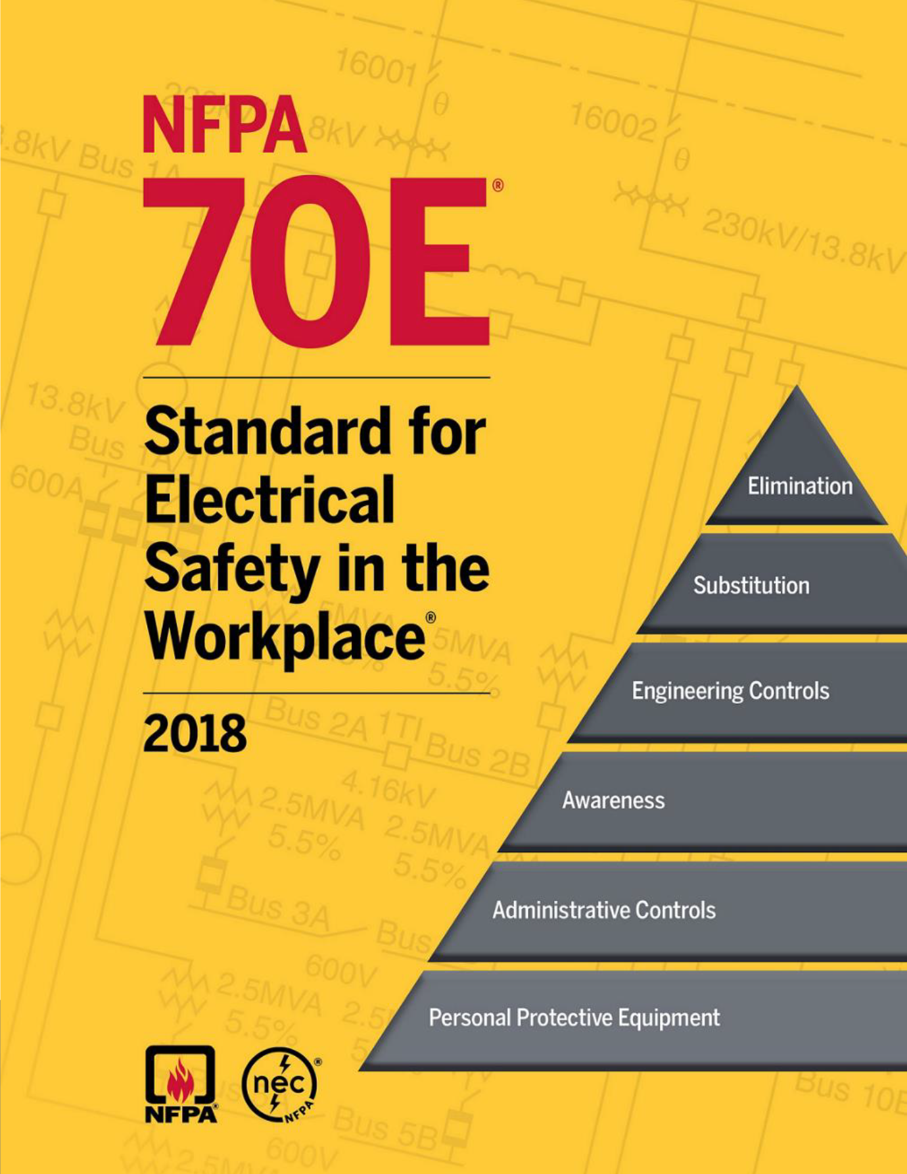

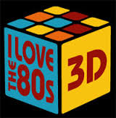



Evolution of NFPA 70E
1979 – Part I
1981 – Part II
1983 – Part III
1988 – Minor revisions
1995 – Limits to approach & arc are introduced
2000 – Use of PPE
2004 – Safe Work practices
2009 – Chpt 4 deleted
2012 – FR to AR
2015 – How stakeholders evaluate electrical risk
2018 – introduces human factors, such as human error
2021 – Minor Revisions
2024- TBD
Notes:
NFPA 70E has been around 40+ years believe it or not.
2000 was the first intro to PPE and ATPV ratings
2012 the term FR/AR was explained. A lot of it came from the Oil boom earlier and all the fabric coming from overseas that didn’t test for arc flash and ATPV ratings but more just on the flash fire they had to define the difference between Flame Resistant clothing and Arc Rated clothing. But know that if it’s AR it’s also FR but NOT vice versa.
2015 eliminate CAT 0
2018 took in human factors/errors into the PPE program and assessment. Simplified to a 2 category approach. The Word SHALL was added as wel and ANNEX Q taking in employee habits.
2021 some minor revisions

Slide 11
NFPA 70E 2024 Edition
  OSHA enforces NFPA 70E under 1910.132 and 1910.335.
Notes:
You know….I’ve watched that video a 1000 times and it still gets me….Donnie was a very lucky man. Unfortunately there are still too many employees that are not as fortunate as Donnie. Today we are going to take a strong step in helping each of you change that.
Hello and good morning….My name is Kevin Best and I am a Regional Director of Protective Apparel at Cintas. For the last 12.5 years I have been designing FR & PPE programs for companies large and small that deal with arc flash, flash fire, & molten metal hazards. I also have the pleasure of having Dave Bingham, National Director of AEDs at Cintas here to discuss our topic today: CPR, AED’s & How They Relate to NFPA 70E.
Couple housekeeping topics:
-Restrooms
-Fire
-Tornado
-FR, PPE, & AED that were handed out (Interactive Presentation)
-Evaluation
We are going to handle our next 60 minutes with you in two segments….discussing arc flash & shock hazards. Both are critical priorities for safety managers. Let’s get started!
Who do we have in the room today? Safety / Operations / Electrical?
How many of you require your employees to work on or near energized parts?

Slide 12
Arc Flash Risk Assessment
A. General
1. To identify arc flash hazards
2. To estimate the likelihood of occurrence of injury or damage to health and the potential severity of injury or damage to health.
3. To determine if additional protective measures are required, including the use of PPE.
F. Arc Flash PPE
1. The incident energy analysis method
2. Arc flash PPE category method
130.5 Page 26

Slide 13
Requirements Summary
Site Risk Assessment
Must be completed every 5 years or if equipment changes have been made
Training
NFPA 70E Arc Flash Training for all employees who work with over 50v and is done every 3 years. First Aid, CPR and AED Training is also required every two years.
PPE / FRC
Must provide correct PPE and FRC
Warning Labels
Updated Labels must be on all equipment that poses an Arc flash risk (3 phase)
Electrical Safety Program (ESP)
Needs to be reviewed and updated every 3 years

Slide 14
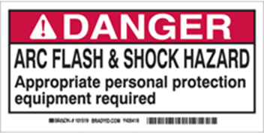

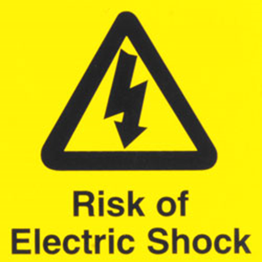
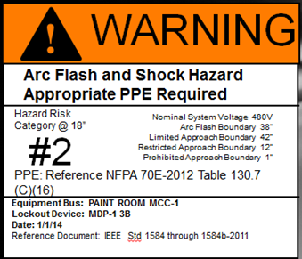
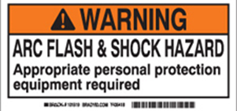
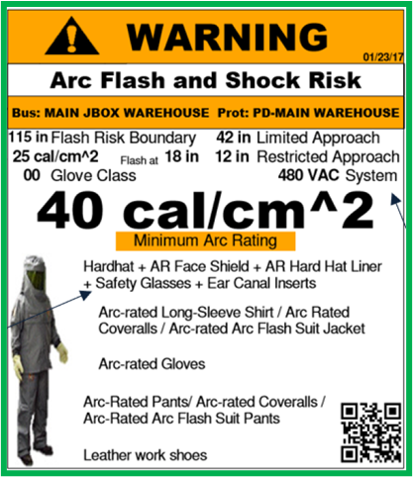
Bad vs Good Labels
Any of these look familiar?

Slide 15
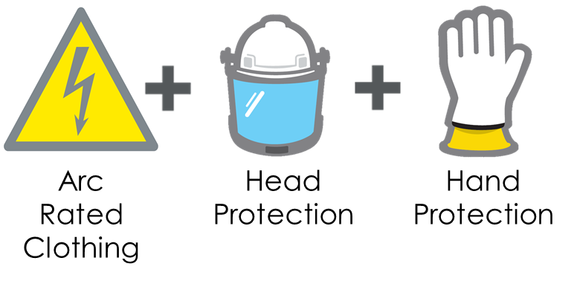

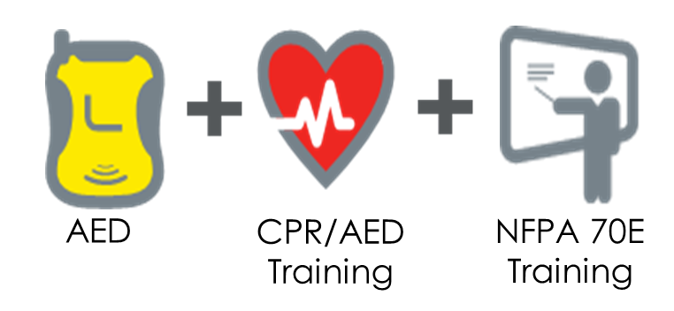
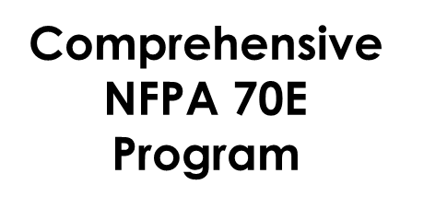

Slide 16
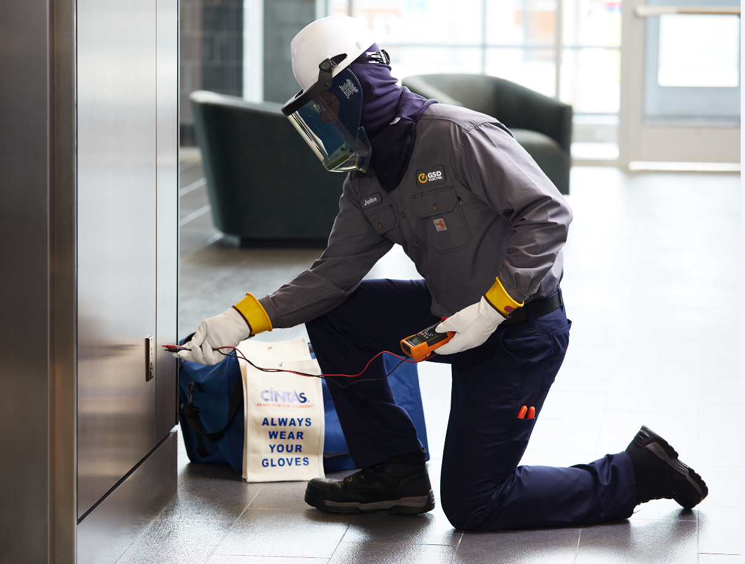
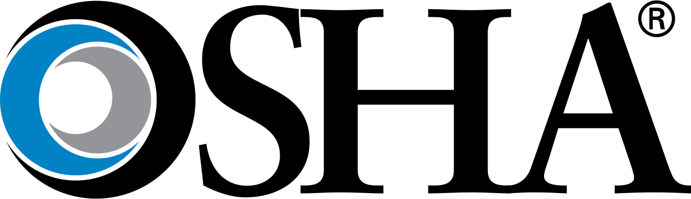
OSHA VS. NFPA 70E
OSHA is the Law
OSHA = DESTINATION
NFPA 70E is a National Consensus Standard
NFPA 70E = ROADMAP
Notes:
After learning and seeing one of these Electric Arc Flash event, you're probably saying to yourself. "Surely the government has rules to protect workers from this hazard".
You would be right. OSHA and NFPA work together protect workers from this dangerous threat.
Enter NFPA 70e
NFPA 70e is an industry standard recognized by OSHA covering electrical safety in the workplace.
NFPA is the National Fire Protection Association. Its members are comprised of companies that use electricity like, Shell Oil, Schneider Electric, General Motors and many more, manufacturers of PPE and the laboratories that test that PPE.
This diverse group of representatives write and update NFPA 70e and release those updates every 3 years. The latest update NFPA 70e – 2021 edition was just released in October of 2020.
NFPA 70e is not the law, however NFPA 70e is recognized by OSHA as the industry standard for electrical safety in workplace. In the event of an injury investigation, OSHA can site failure to follow NFPA 70e when levying fines.
Think of OSHA as the destination…..and NFPA 70E as the GPS/Roadmap.
So, OSHA tells companies they need to protect their workers from electrical hazards (the destination). NFPA 70e shows companies the steps to follow (the roadmap) create policies and procedures in order protect their companies from the electrical hazards.
(pause and poll audience for understanding)
Does that make sense?
So, let me ask a question, does the NFPA have the ability to levy fines?
Another way to the put it is the Shall and How. OSHA says you SHALL protect your workers for electrical hazards and NFPA 70e shows you HOW to protect your workers.

Slide 17
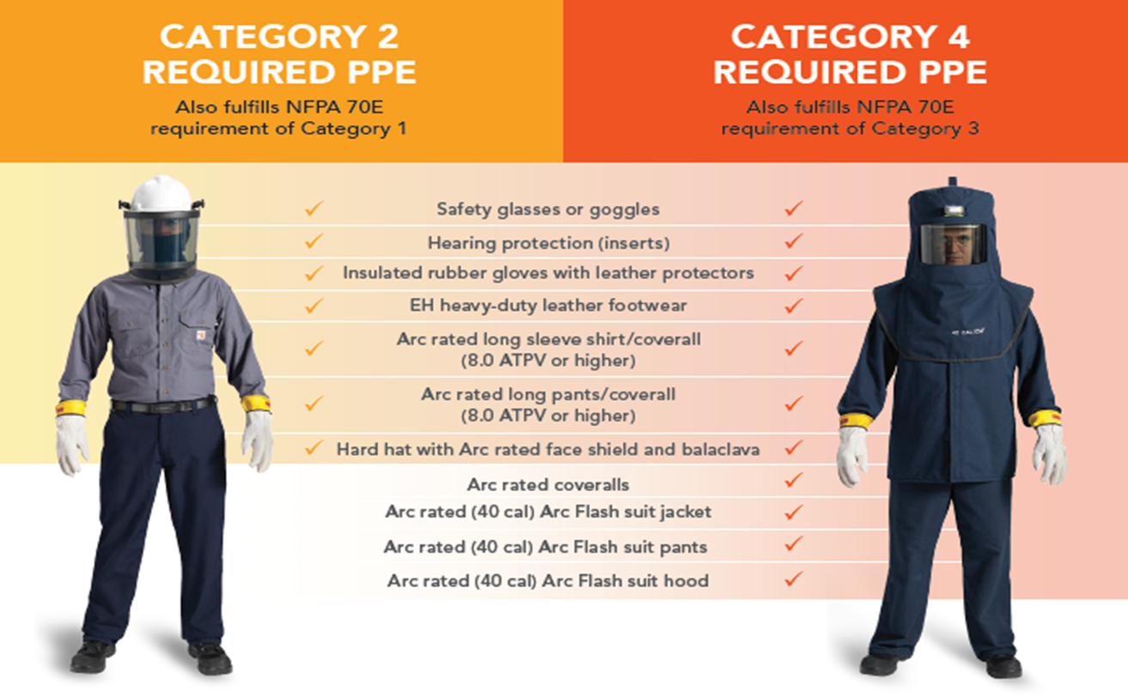

Slide 18
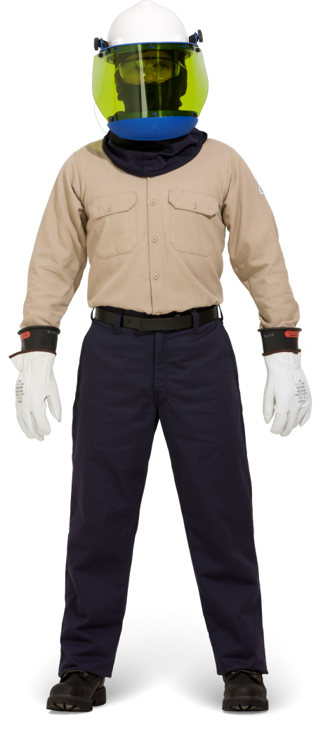
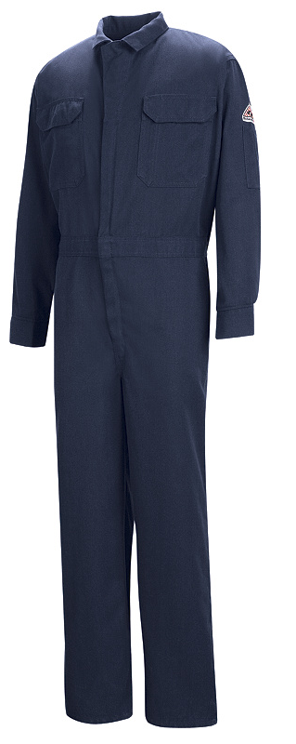
Daily wear vs. Task Wear
Notes:
A daily wear program is a individual issued FR/AR clothing program for your employee and it’s clean and ready daily. Typically a shirt and pant combo. The employee will have enough sets for them to work each week without rewearing that week. Employees don’t have to worry about switching clothes when they go do their work. They will also have a head and hand kit issued to them individually.
A task based program is typically a coverall and head and hand kit. And typically shared among employees. Typically they will either put on some of the kit or none as they have done the job a million times. This is where Annex Q in 2018 came into play with human error factored into your electrical safety program. Many tell me they have a policy of what their electrical team has to do but have very little oversight and trust their employees will make the right decision 100% of the time. Think about this. Your electrical maintenance employee is working on the 3rd floor of a building and they have a task kit with them but it’s in the truck. They have open a panel and it’s January in Minnesota and it’s -20 and your employee has done this job many times. Do you think they will take the time to go down 3 flights of stairs go outside, grab the kit then back up 3 flights of stairs or elevator and then put on the coverall and gloves and head kits properly? Also, are they going to be wearing 100% cotton clothes underneath that coverall or FR base layer clothing or will they have a cotton poly blend or a Nike Dri Fit base layer? Do you want to take that risk guessing? Again, this was finally addressed in 2018 edition with human error.

Slide 19
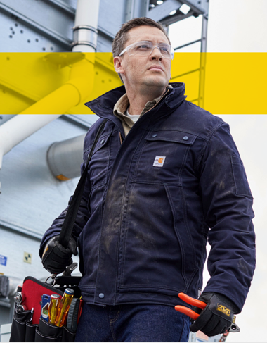
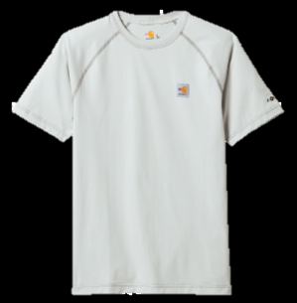
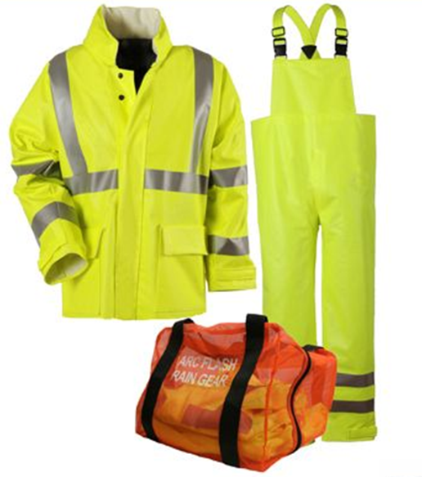

FRC Standards for Outerwear and Undergarments
Standards and Regulations
NFPA 70E 130.7 (c)(9)(b)- Outer Layers
Garments worn as outer layers over arc-rated clothing, such as jackets or rainwear, shall also be made from arc-rated material.
NFPA 70E 130.7 (c)(9)(c)- Underlayers
Meltable fibers such as acetate, nylon, polyester, polypropylene, and spandex shall not be permitted in fabric underlayers (An incidental amount of elastic used on nomelting fabric underwear or socks shall be permitted.

Slide 20
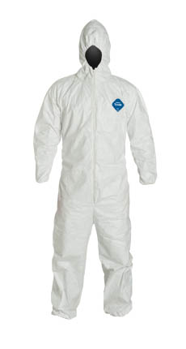
Arc Rated Clothing Proper Use
X
Always the outermost layer
All natural, non-melting undergarments
Clean, no flammable contaminants
Repaired correctly and removed from service when needed

Slide 21
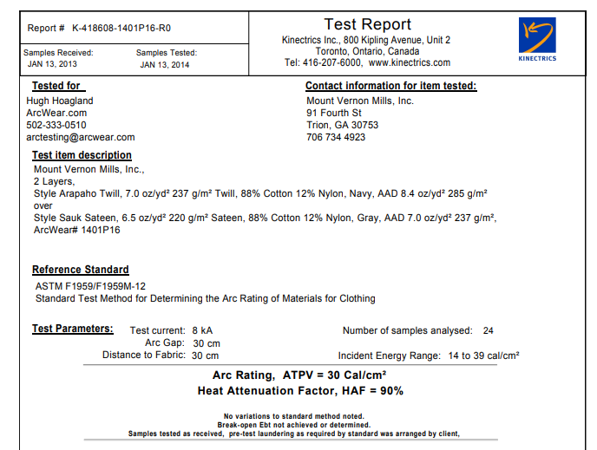
Arc Rated Clothing Layering Understand
Must have it certified tested. Cannot just add the labels together.
Many of the fabric manufactures have testing for their fabric only.
Typically seen when needing over 12 cals and don’t want arc suits

Slide 22
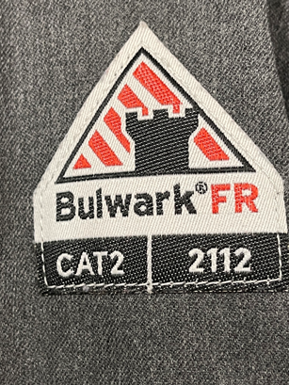
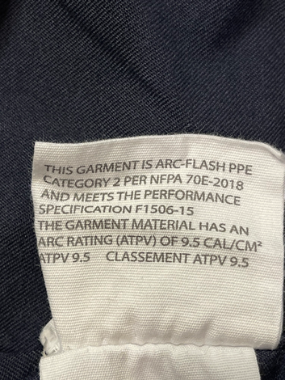
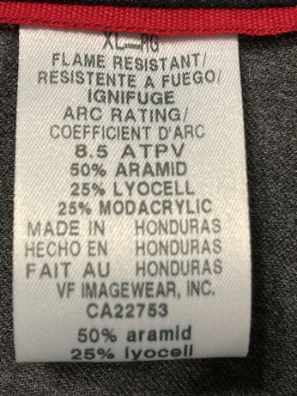
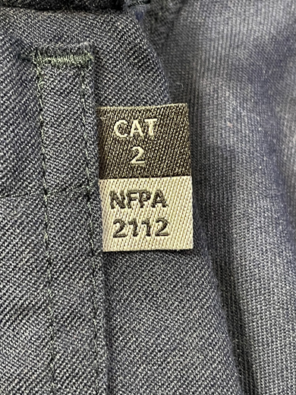
Arc Rated Clothing Proper Labels
Needs to show ATPV/EBT Rating
Fabric Information
ARC Cat and NFPA 2112 Label outside label
UL Certification
ASTM F1506 and ASTM F1595
Many on Amazon don’t have this and Amazon is not responsible

Slide 23
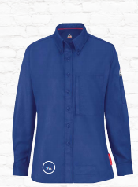
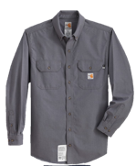
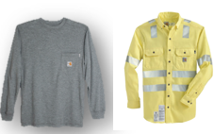
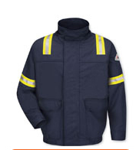


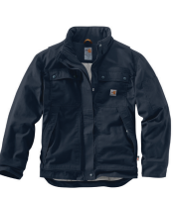

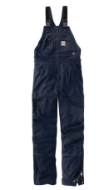
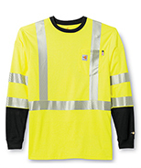
Retail Inspired Clothing is here!!!
AND
WOMEN’s FRC Clothing is available

Slide 24
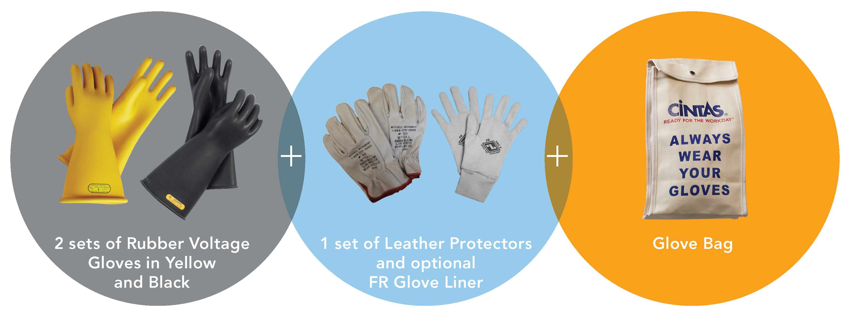
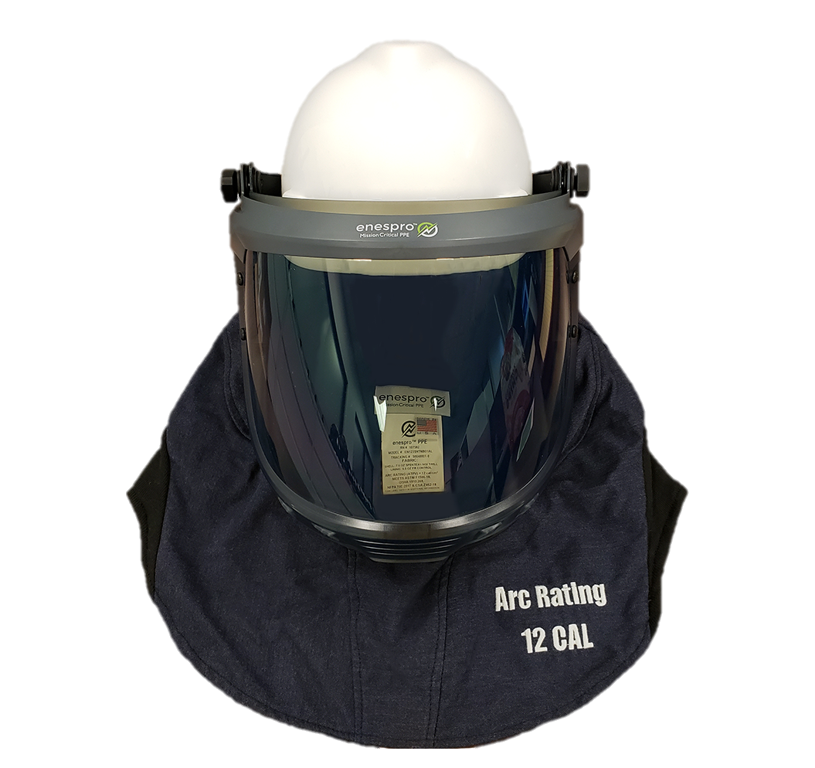
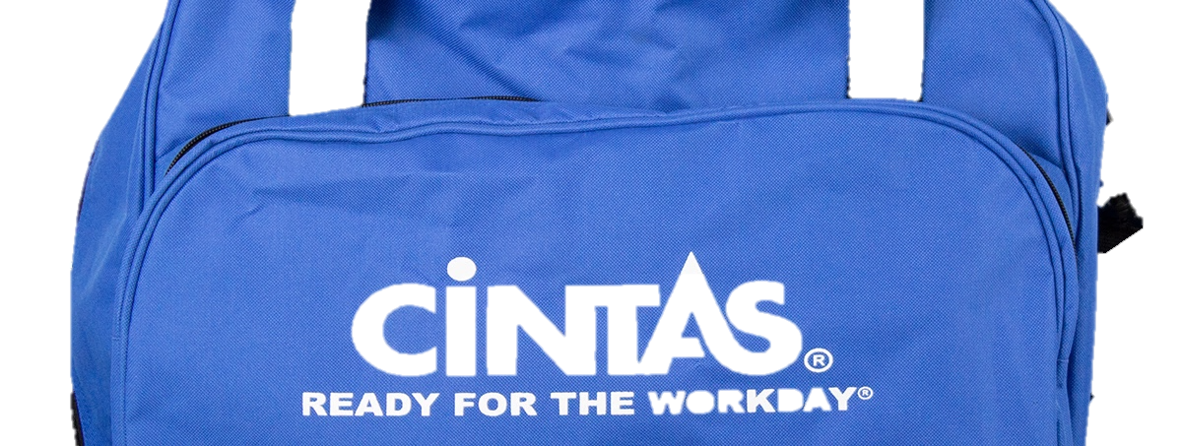
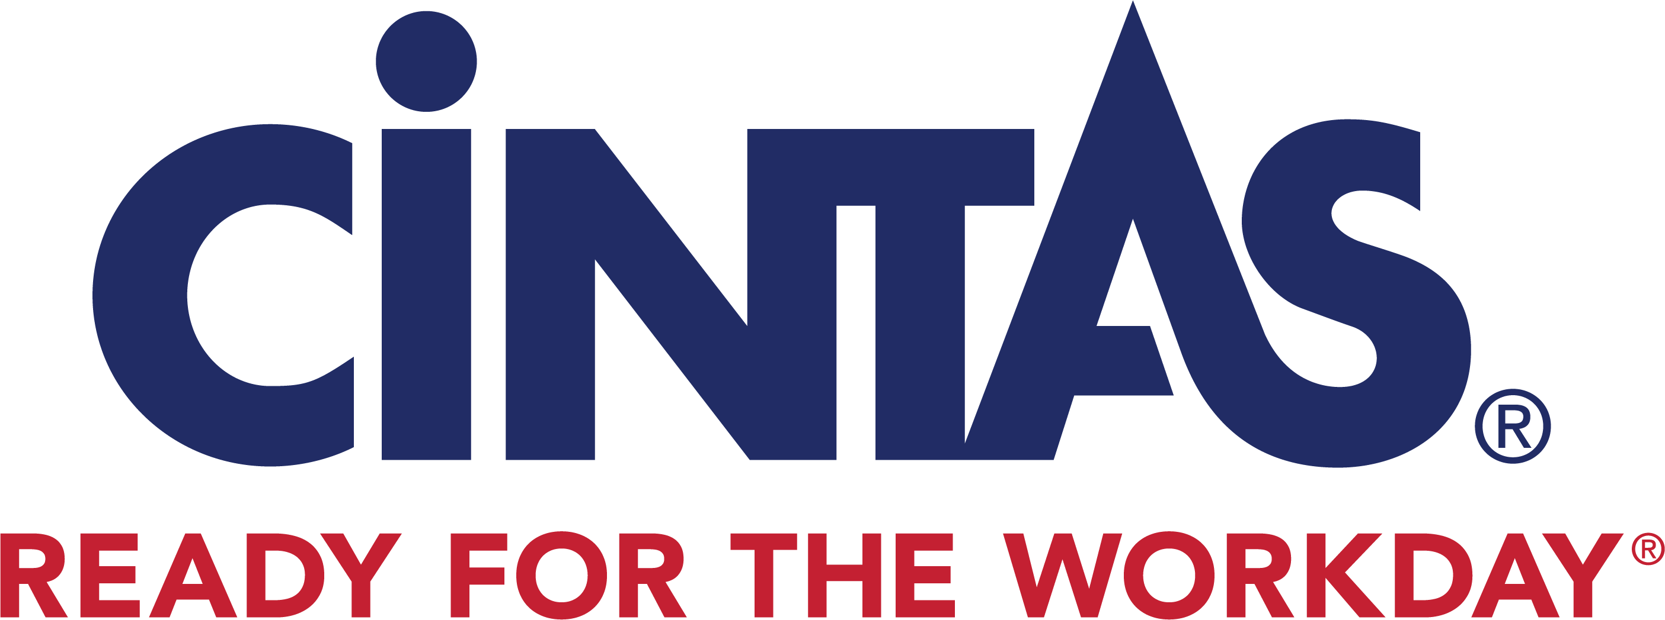
HEAD AND HAND PROTECTION REDEFINED
HAND PROTECTION
In the Cintas managed program, each wearer is issued:
ARC rated Flash Suit Hood
Gear Bag

Slide 25
Care & Maintenance
Inspection
Manufacturers Instructions
Storage
Cleaning, Repairing, and Affixing Items.
Key word is SHALL!
See details on Page 32
Notes:
Read Pg 32 some key points

Slide 26
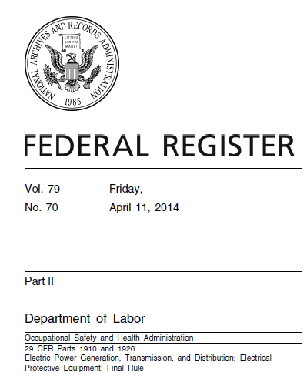

Important Considerations
“The OSH Act and the PPE standards at 1910.132 and 1926.96 make the employer, not the employee, responsible for the care and maintenance of PPE.”
“If employers rely on home laundering of the clothing, they must train their employees in proper laundering procedures and techniques, and employers must inspect the clothing on a regular basis to ensure that it is not in need of repair or replacement.”
“The Agency is not prohibiting home laundering of FR and arc-rated clothing. However, to comply with 1910.132 or 1926.95, employers cannot simply instruct employees to follow manufacturers’ instructions.”
Notes:
For those who don’t outsource their FR/AR uniform programs you should be aware of the following with OSHA. Home laundry is absolutely allowed but it’s not longer okay to just buy the clothes and tell your employees to follow what the tags say from the manufacture. You need to train proper washing, care, inspection and when something needs to be replaced. Some companies I’ve worked with do this training each year when they order clothes, some do it once when they are hired and that’s it and some have print outs to give the employees and some unfortuetly don’t train because they probably are not aware of the employers reasonability.

Slide 27
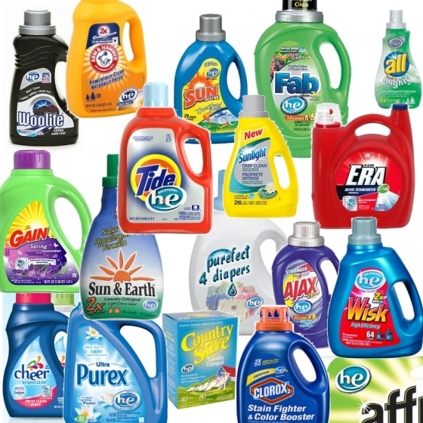
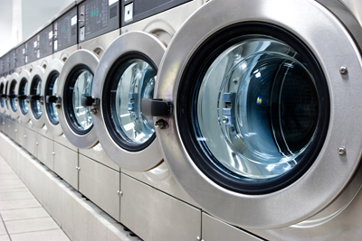
Before You Home Launder…
Do not use:
chlorine bleach
hydrogen peroxide
starch
fabric softeners
pretreatment products
Use soft water
Launder home and arc rated garments separately.

Slide 28

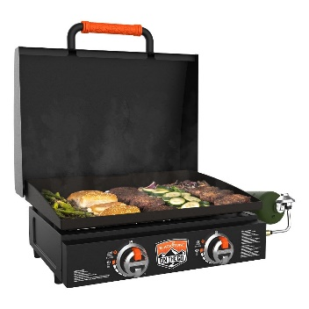
Conclusions & Next Steps
Set a meeting with your leadership
Present/Discuss changes
Take action
Make improvements
Train & re-train
Revisit Electrical Safety with every NFPA 70E Revision
BLACKSTONE Drawing!!
Notes:
So I gave a lot of information today and if we wrap this up with a bow here are some key takeaways I came up with.
Get a copy of NFPA 70e 2021 and meet w. leadership
Find the gaps in your current program and discuss changes (I’d love to help you if you would want)
Safety is always moving forward and always needing education no matter the industry.

Slide 29
Thank You!
Drew Simashkevich
Regional Manager – Protective Apparel
614-578-3411
SimashkevichD@cintas.com
Notes:
Thank you again for your time and if I can help any of you today or in the future with your FR/AR needs, training and compliance education needs or anything around safety please let me know.

